Slide 1
Flight booking management system
Vineeth Shettigar – 4MT21CS181

Slide 2
Problem statement
To design develop and implement a code for a flight management system.

Slide 3
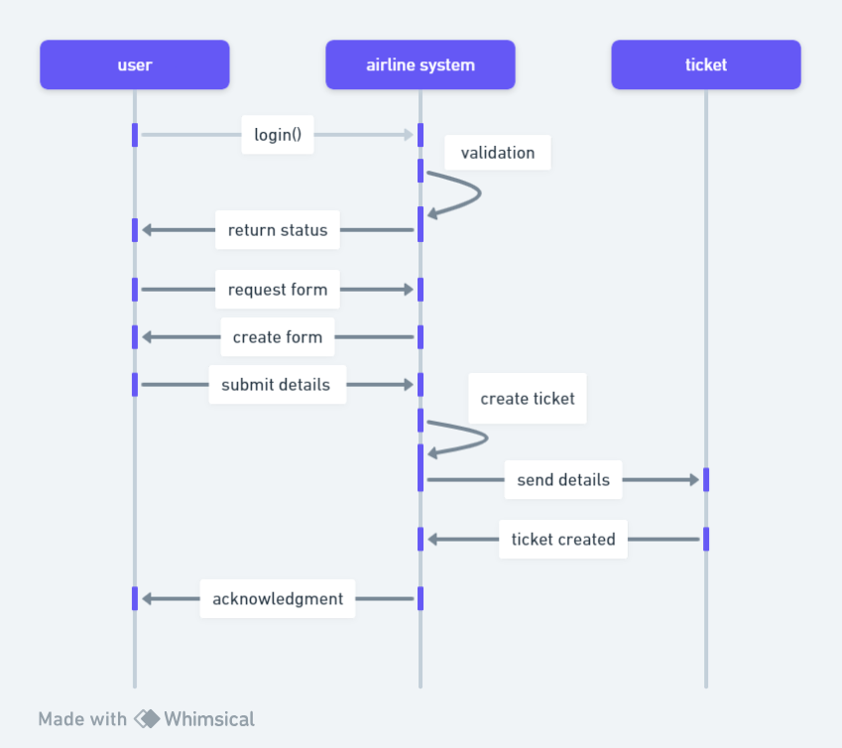
Sequence diagram

Slide 4
Tools and libraries used
Java I/O (java.io.*)
Java collections (java.util.*)
Serialization ( serializable interface)
Scanner (java.util.Scanner)
File I/O
Stream API
Exception Handling

Slide 5
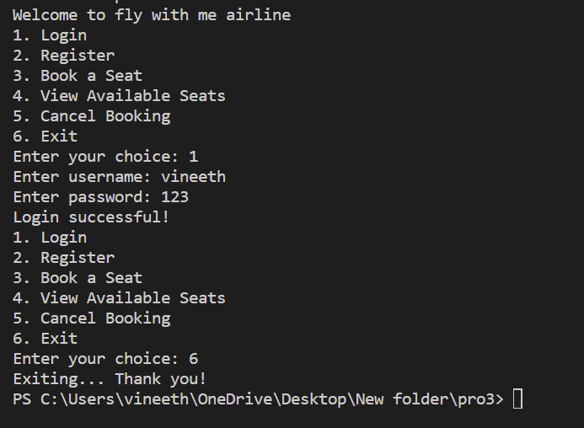
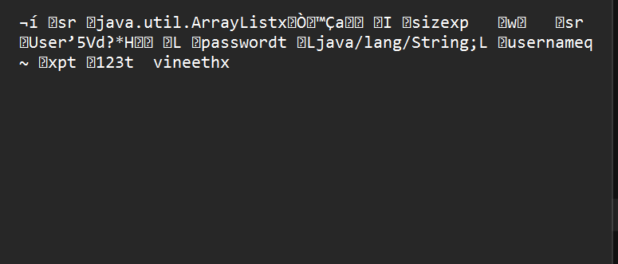
Screenshot’s of programme output and File I/O
Screenshot of user serial file
Screenshot of Output terminal

Slide 6
Future plans
To design an GUI for the booking system.
Adding more security features to keep the data of the user secure.
Also implementing an ML model to predict the future prices of the seats to help the customer to predict prices in the festive seasons.
implementing a feedback loop so we can improve our programme.

Slide 7


